Slide 1
Social Media Marketing
MS 491-II
Group Number - 10
Ajay Karwasara 19110142
Deepak Patel 19110010
Satyam Anand 19110135
Siddharth Joshi 19110169

Slide 2
Introduction
In this presentation, we are going to analyze the price and sales of product of different brands such as Private, Sunshine, Nobisco and Keebler (Dataset).
We have dataset of 136 households making about 3292 total purchase.
We will also see the dependence of price and sales of a particular brand on the display at the store or feature on the store magazine.
This analysis will help us develop new strategies for the brands to increase their sales and profits.

Slide 3
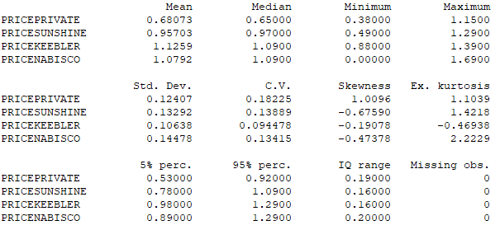
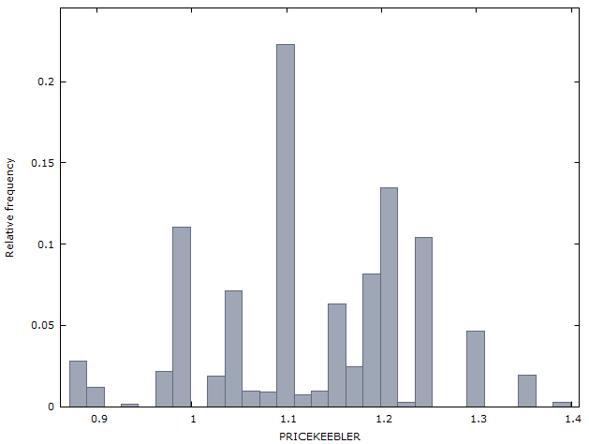
Full Summary Statistics of Price
Full Summary Statistics
Relative frequency of price of Keebler brand

Slide 4
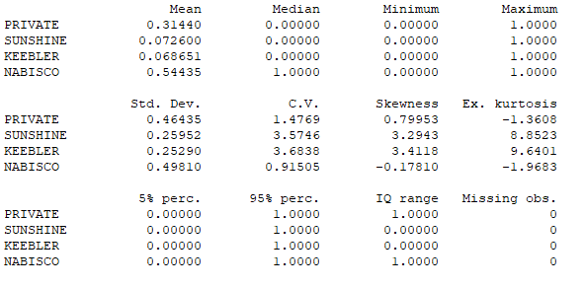
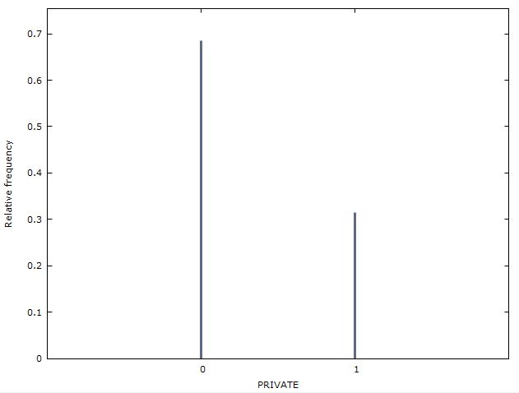
Full Summary Statistics of Sales
Full Summary Statistics
Relative frequency of sales of Private brand

Slide 5
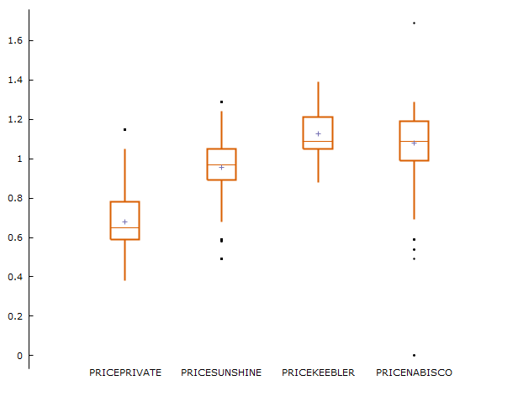
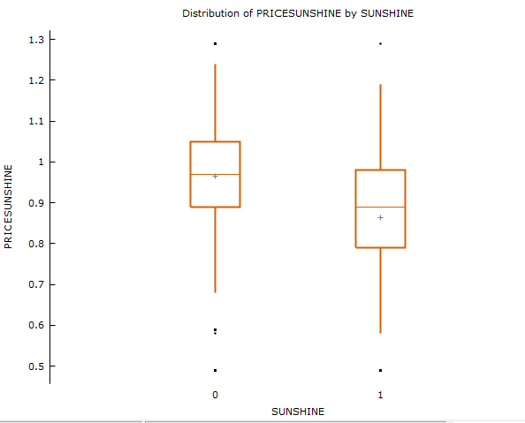
Boxplots and Factorized Boxplots
Factorized Boxplot
(Price_sunshine Vs Sale_sunshine)
Boxplot of price of various brands

Slide 6
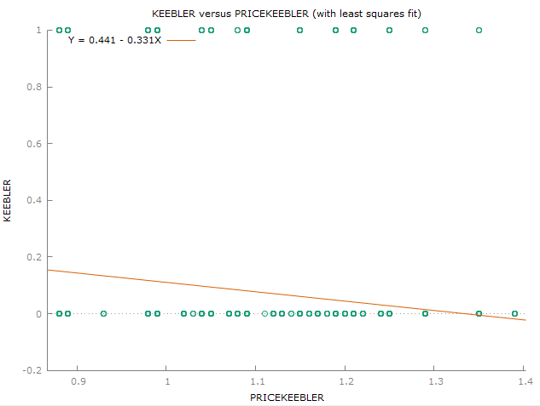
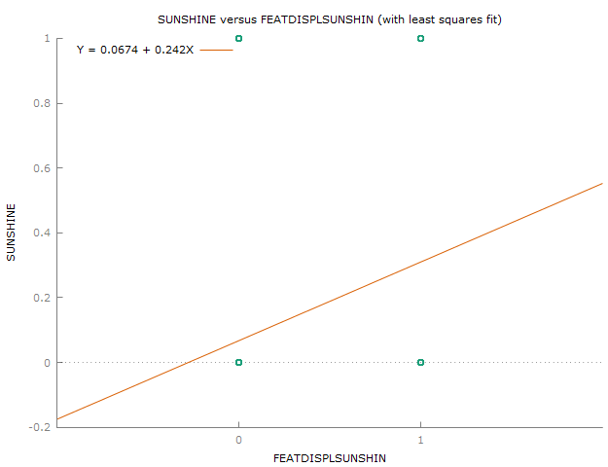
X-Y Scatter Plots
Plot of Price_Keebler Vs Sales_Keebler
Plot of FeatDispl_Sunshine Vs Sales_Sunshine

Slide 7


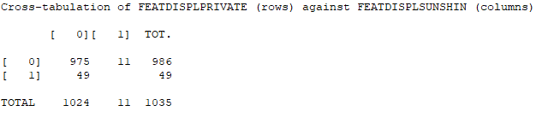
Restricted dataset (when Private brand is bought, i.e., PRIVATE == 1)
Summary Statistics of price
Summary Statistics of feature and display
Cross Tabulation (Feat_Displ_Private Vs Feat_Displ_Sunshine

Slide 8


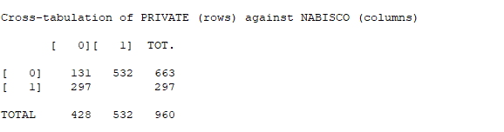
Restricted Dataset (when Nabisco is displayed, i.e., DISPLNABISCO == 1)
Summary Statistics of sales
Summary Statistics of price
Cross Tabulation
(Private Sales Vs Nabisco Sales)

Slide 9


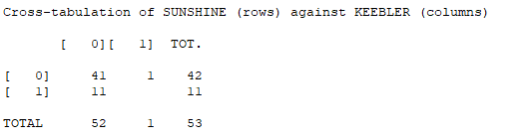
Restricted Dataset (when Sunshine is featured, i.e., FEATSUNSHINE == 1)
Summary Statistics of sales
Summary Statistics of price
Cross Tabulation
(Sunshine Sales Vs Keebler Sales)
Notes:
Hello everyone. So, in this slide, we have restricted the dataset to only those cases when sunshine brand is featured and that leaves only 53 observations and all other observations are dropped. The first table shows the mean of the sales of each brand and for the sunshine brand it is 0.2075 here, and earlier when the dataset was not restricted the mean of the sales of sunshine brand was 0.0726. So, we can see the positive impact of featuring the sunshine brand on its sales. Now, coming to the next table, it contains the statistics of price of each brand when the dataset is restricted. So, the mean price for the sunshine brand here is 0.7443 and it was about 0.95703 when dataset was not restricted. So, it shows that the price of this brand is decreased if it is featured in a magazine. Now, last is the cross tabulation table between the sales of sunshine brand which is in rows and keebler brand which is in columns. So, from this table we can conclude that there are 41 cases when sunshine is featured but neither of the brands are bought, and 11 cases when sunshine is featured and bought and 1 case when sunshine is featured but keebler brand is bought. Next slide.

Slide 10


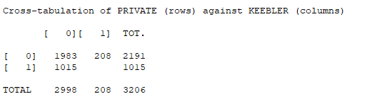
Restricted Dataset
(when Keebler is not featured and displayed, i.e., FEATDISPLKEEBLER == 0)
Summary Statistics of sales
Summary Statistics of price
Cross Tabulation
(Private Sales Vs Keebler Sales)
Notes:
Now, in this slide the dataset is restricted to only those cases when keebler brand is neither featured nor displayed. After restricting the dataset we are left with only 3206 cases and all other observations are dropped from the dataset. So, now if we see the first table that represents the statistics of the sales of each brand, we can see the mean sale of keebler brand is 0.06488 and the mean sale was about 0.068651 when the data was not restricted. So we can conclude that the sale of keebler brand decreases if it is not featured and displayed. From the second table also, we can see the statistics of price of each brand when the dataset is restricted. The last table is the cross tabulation table between the sales of private brand which is in rows and the keebler brand which is in columns. From this table we can say that there are 1983 cases when neither private nor keebler brand is bought when keebler is not featured and displayed and 1015 cases when private brand is bought when keebler is not featured and displayed and 208 cases when keebler is bought even if it is not featured and displayed. Next slide.

Slide 11
Conclusion
Majority of the market is occupied by the Nabisco brand (54.435%) despite of it having the second highest mean price (1.0792).
Mean price of Keebler brand is highest (1.1259) and its share in the market is about 6.86%.
We have also observed the maximum standard deviation from the mean price in the case of Nabisco brand (0.14478) and minimum standard deviation in the case of Keebler brand (0.10638).
Featuring a brand in the store magazine or displaying it in the store have proved to be useful for increasing the sale of that particular brand.
Notes:
So the final conclusion is that, despite having the second highest mean price of about 1.0792, the Nabisco brand has the majority of the market about 54.435 percent. The Keebler brand has the highest average price 1.1259 and a market share of 6.86 percent. The maximum standard deviation from the mean price is for the Nabisco brand that is 0.14478 and the minimum standard deviation is for the Keebler brand that is 0.10638. Also, including a brand in the shop magazine or showing it in the store has shown to be effective in improving brand sales.
So, that’s all from our group. Thank You.

